Slide 1
Crossley Farm Superfund site: Temperature Monitoring in the West Branch of the Perkiomen and Unnamed Tributary
US EPA Region 3
December 15, 2025
Leslee Everett – Remedial Project Manager
Tim Gallagher – Remedial Project Manager
John Brakeall – Community Involvement Coordinator
Matt Taynor – Biological Technical Assistance Group

Slide 2
Site History Overview
Event | Date
Disposal of Waste at Crossley Farm | 1960s – 1970s
Crossley Farm added into Superfund Program | 1992
EPA installation of Point of Entry Treatment Systems | 1986 - 2000
EPA installation of Vapor Intrusion Systems | 2006 - 2015
EPA construction of Treatment Plant for Valley Plume | 2010 – 2012
EPA upgrades and expansion of Treatment Plant for Source Area | 2023 - 2025

Slide 3
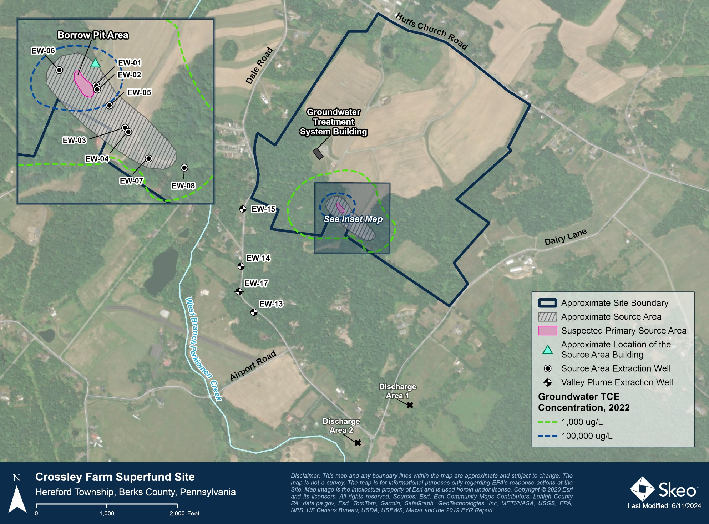
Site Location Map

Slide 4
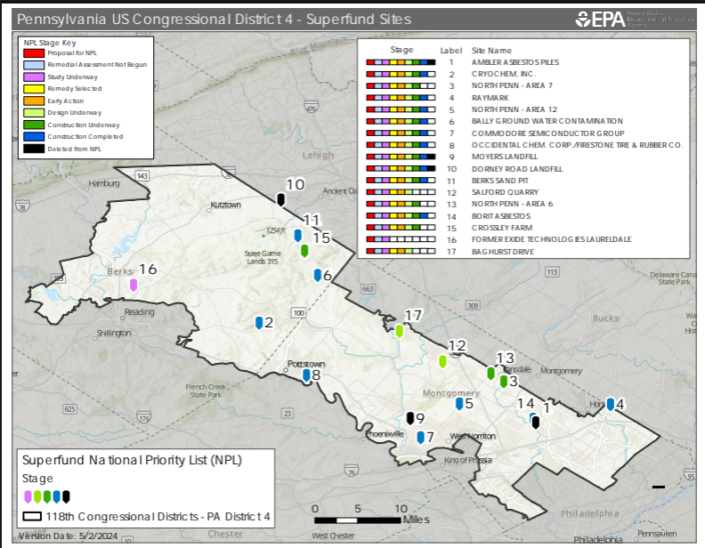

Slide 5
EPA Region 3 Biological Technical Assistance Group (BTAG)
Plan, conduct, and analyze ecological risk assessments
Look at everything non-human
Work on removal, remedial, and federal facility sites
Work post remedial action on restoration and monitoring of sites
Point group for work with Trustees (US FWS and NOAA)

Slide 6
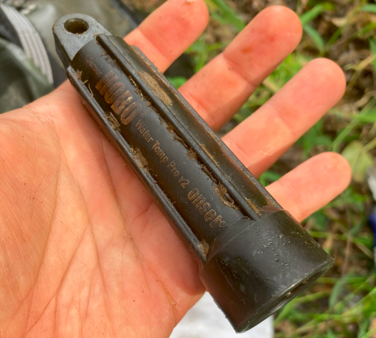
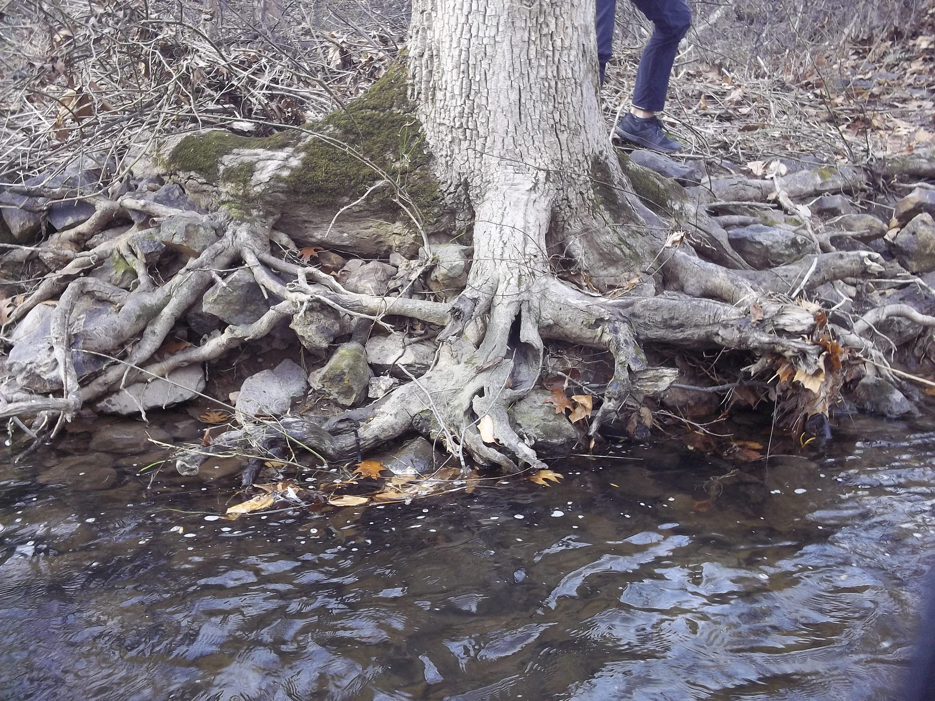
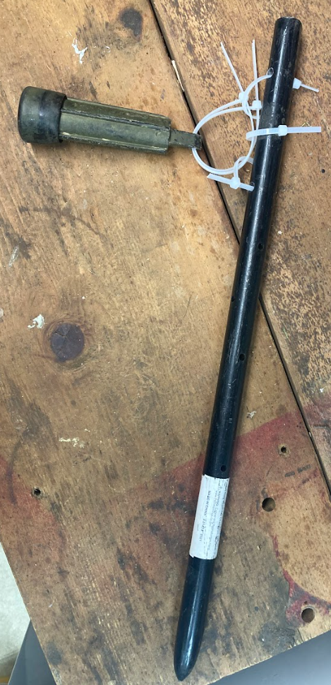
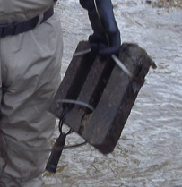
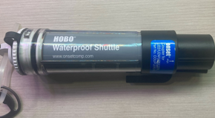
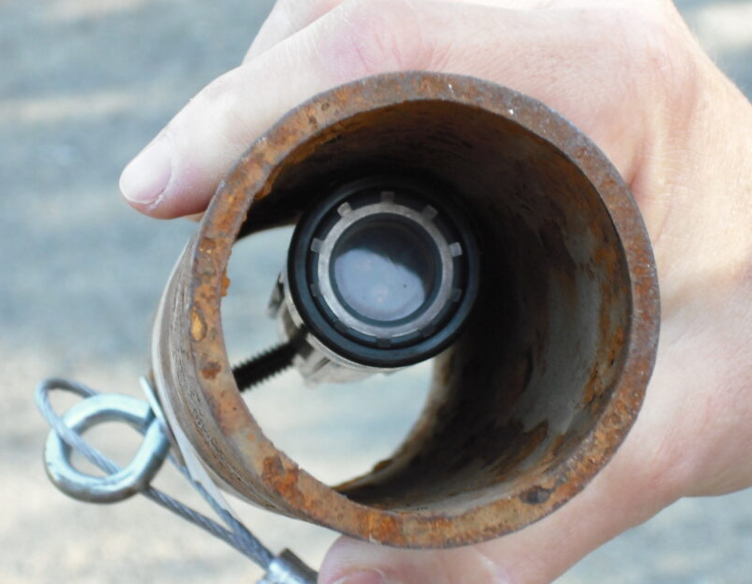
What we do in the creek

Slide 7
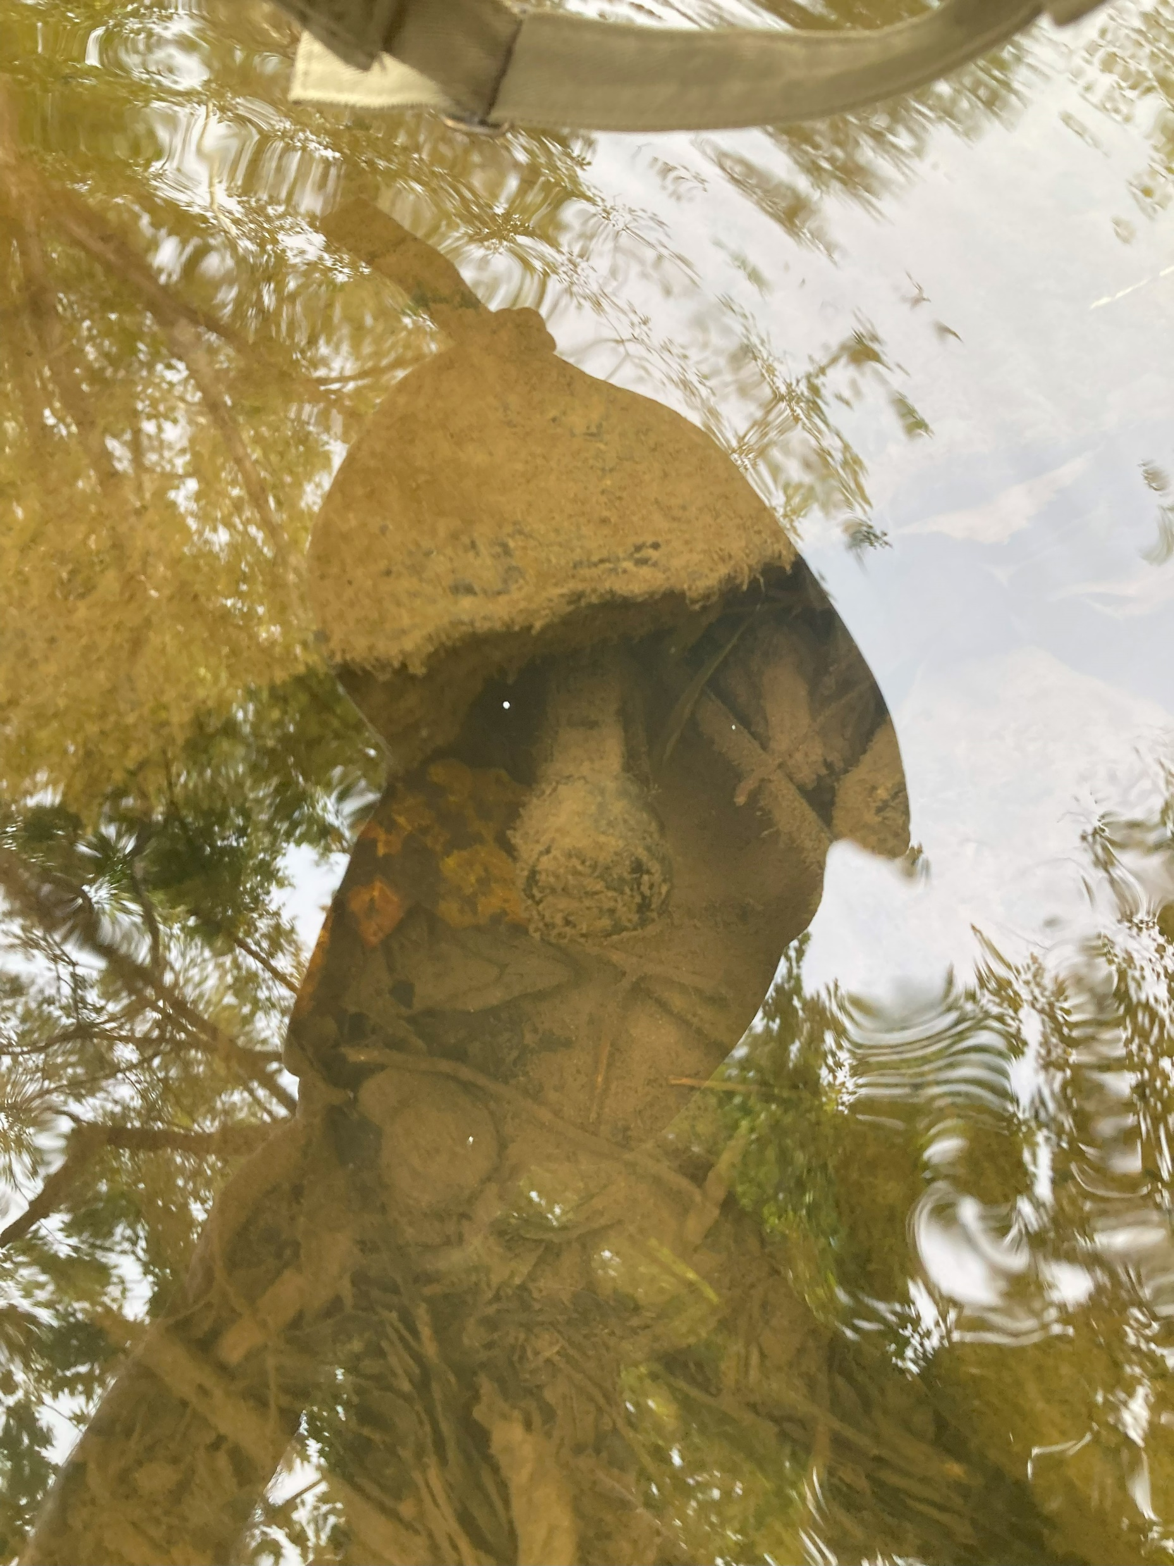
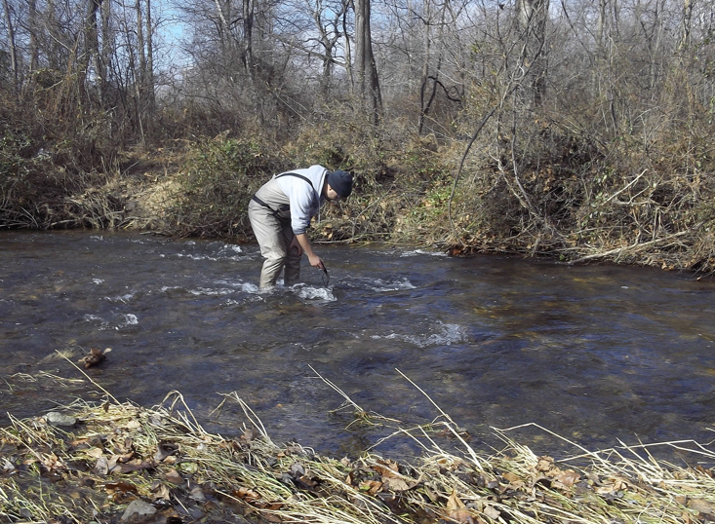
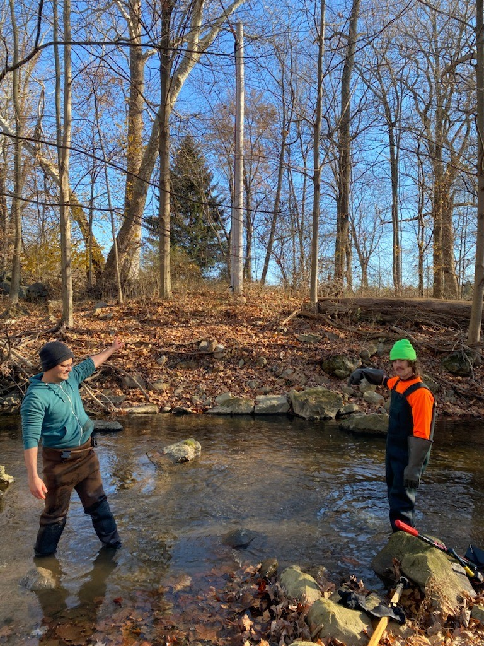

Slide 8
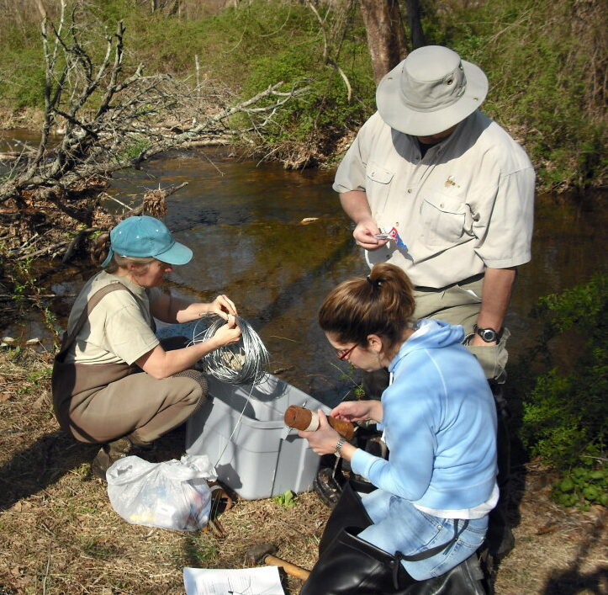
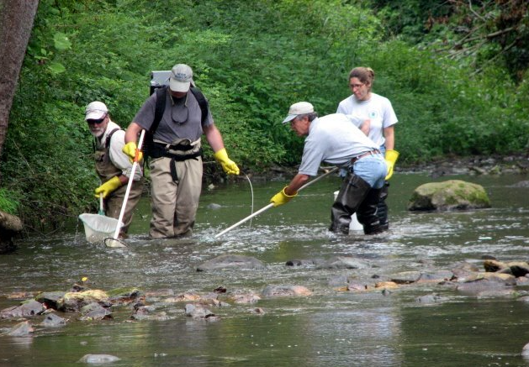
History of Temperature Sampling
2008 - FWS, PA DEP, and EPA selected locations for benthic and fish studies
2008- Current – Yearly sampling
Erosion issue and loss of probes

Slide 9
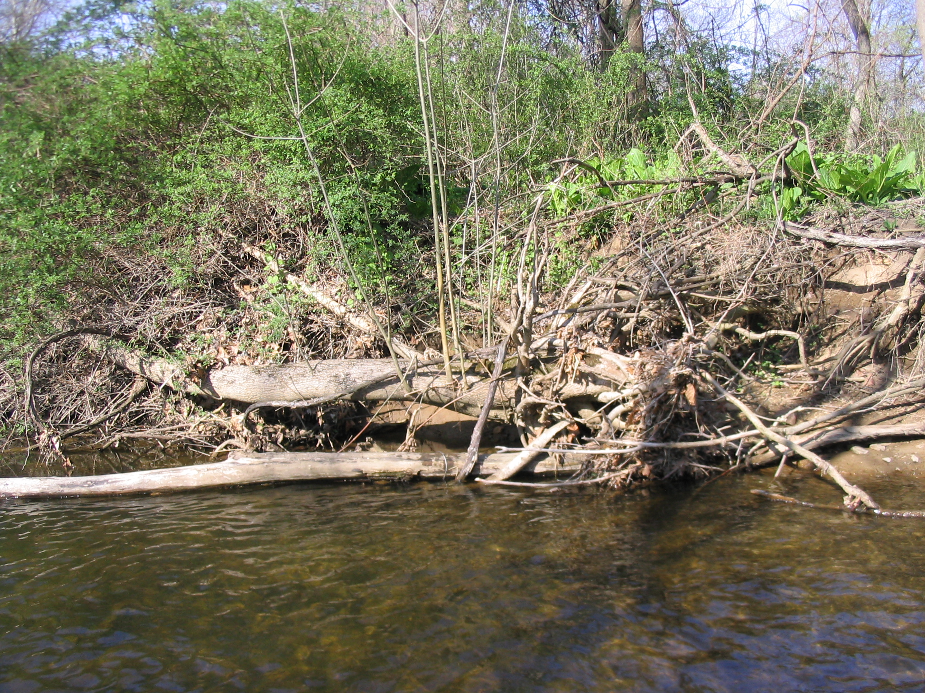
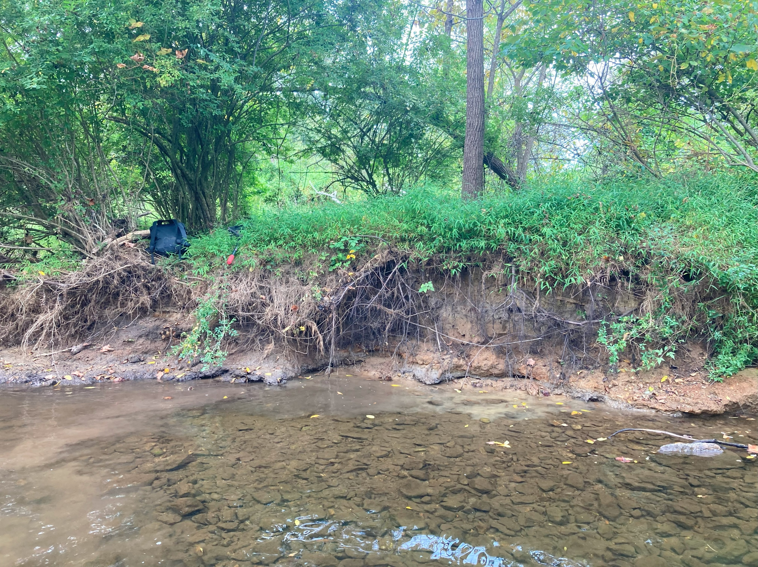
2008
(Location: Furthest downstream probe of Discharge 2)
2025
(Location: Furthest downstream probe of Discharge 2)

Slide 10
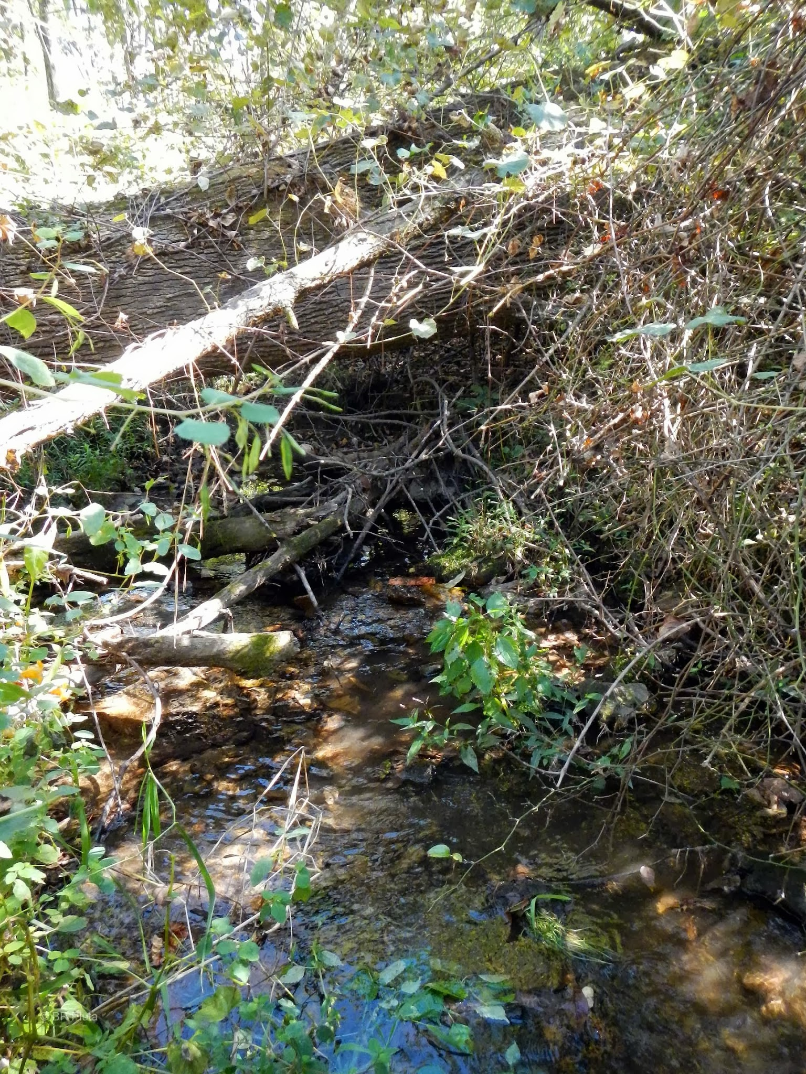
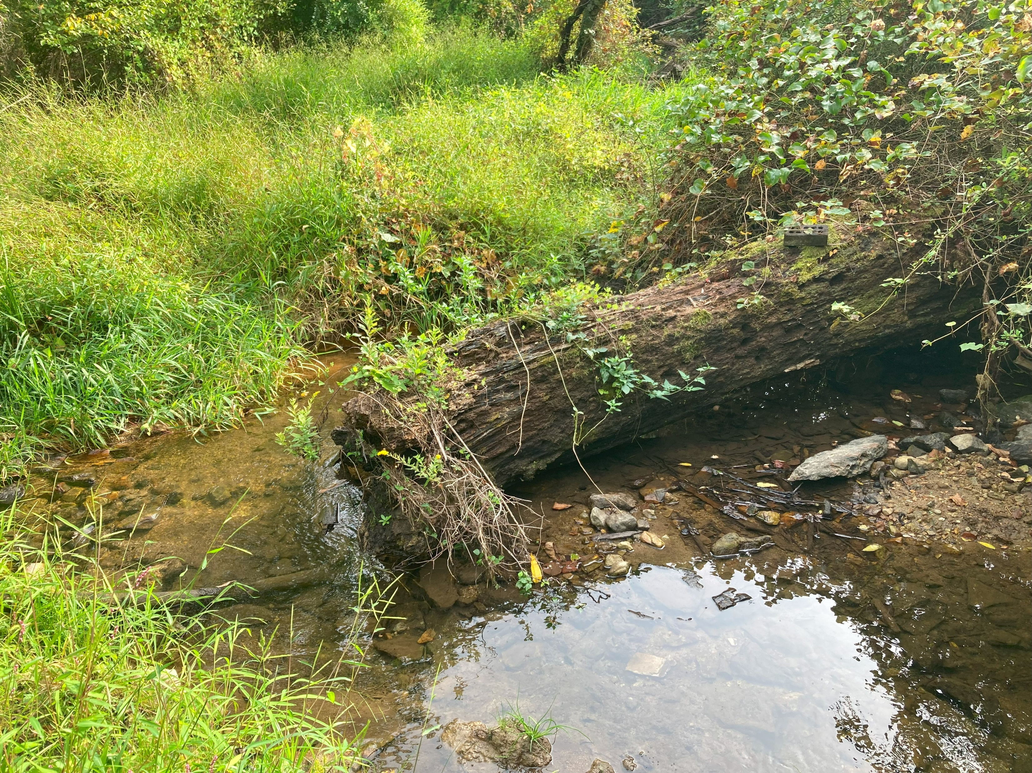
2013
(Location: Probe upstream of Discharge 1)
2025
(Location: Probe upstream of Discharge 1)

Slide 11
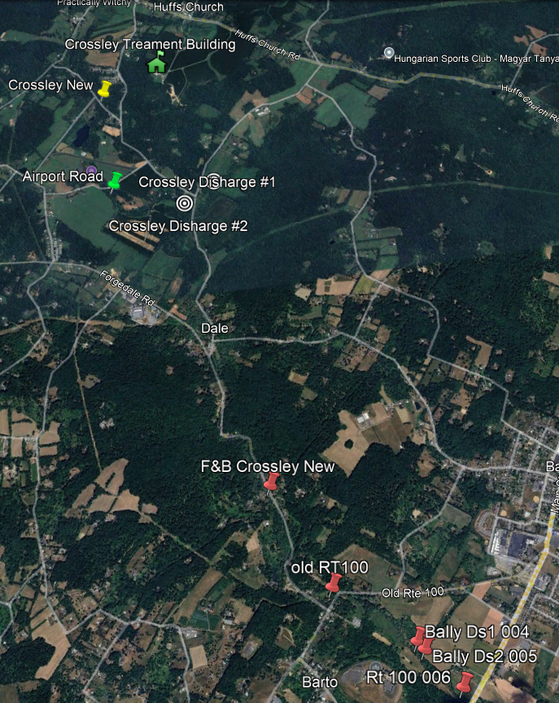
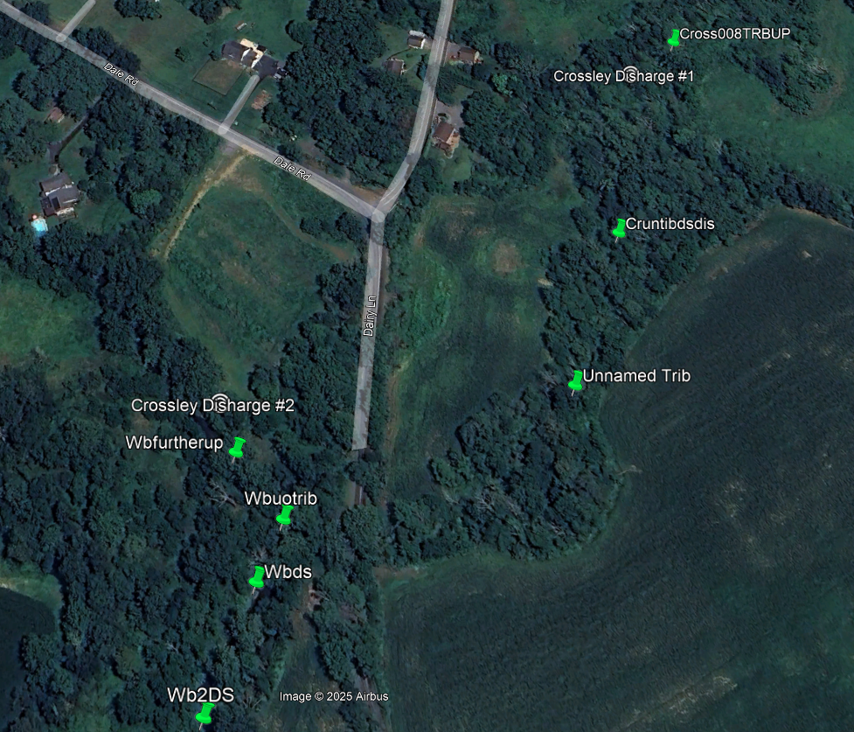
Temperature Probe Locations

Slide 12
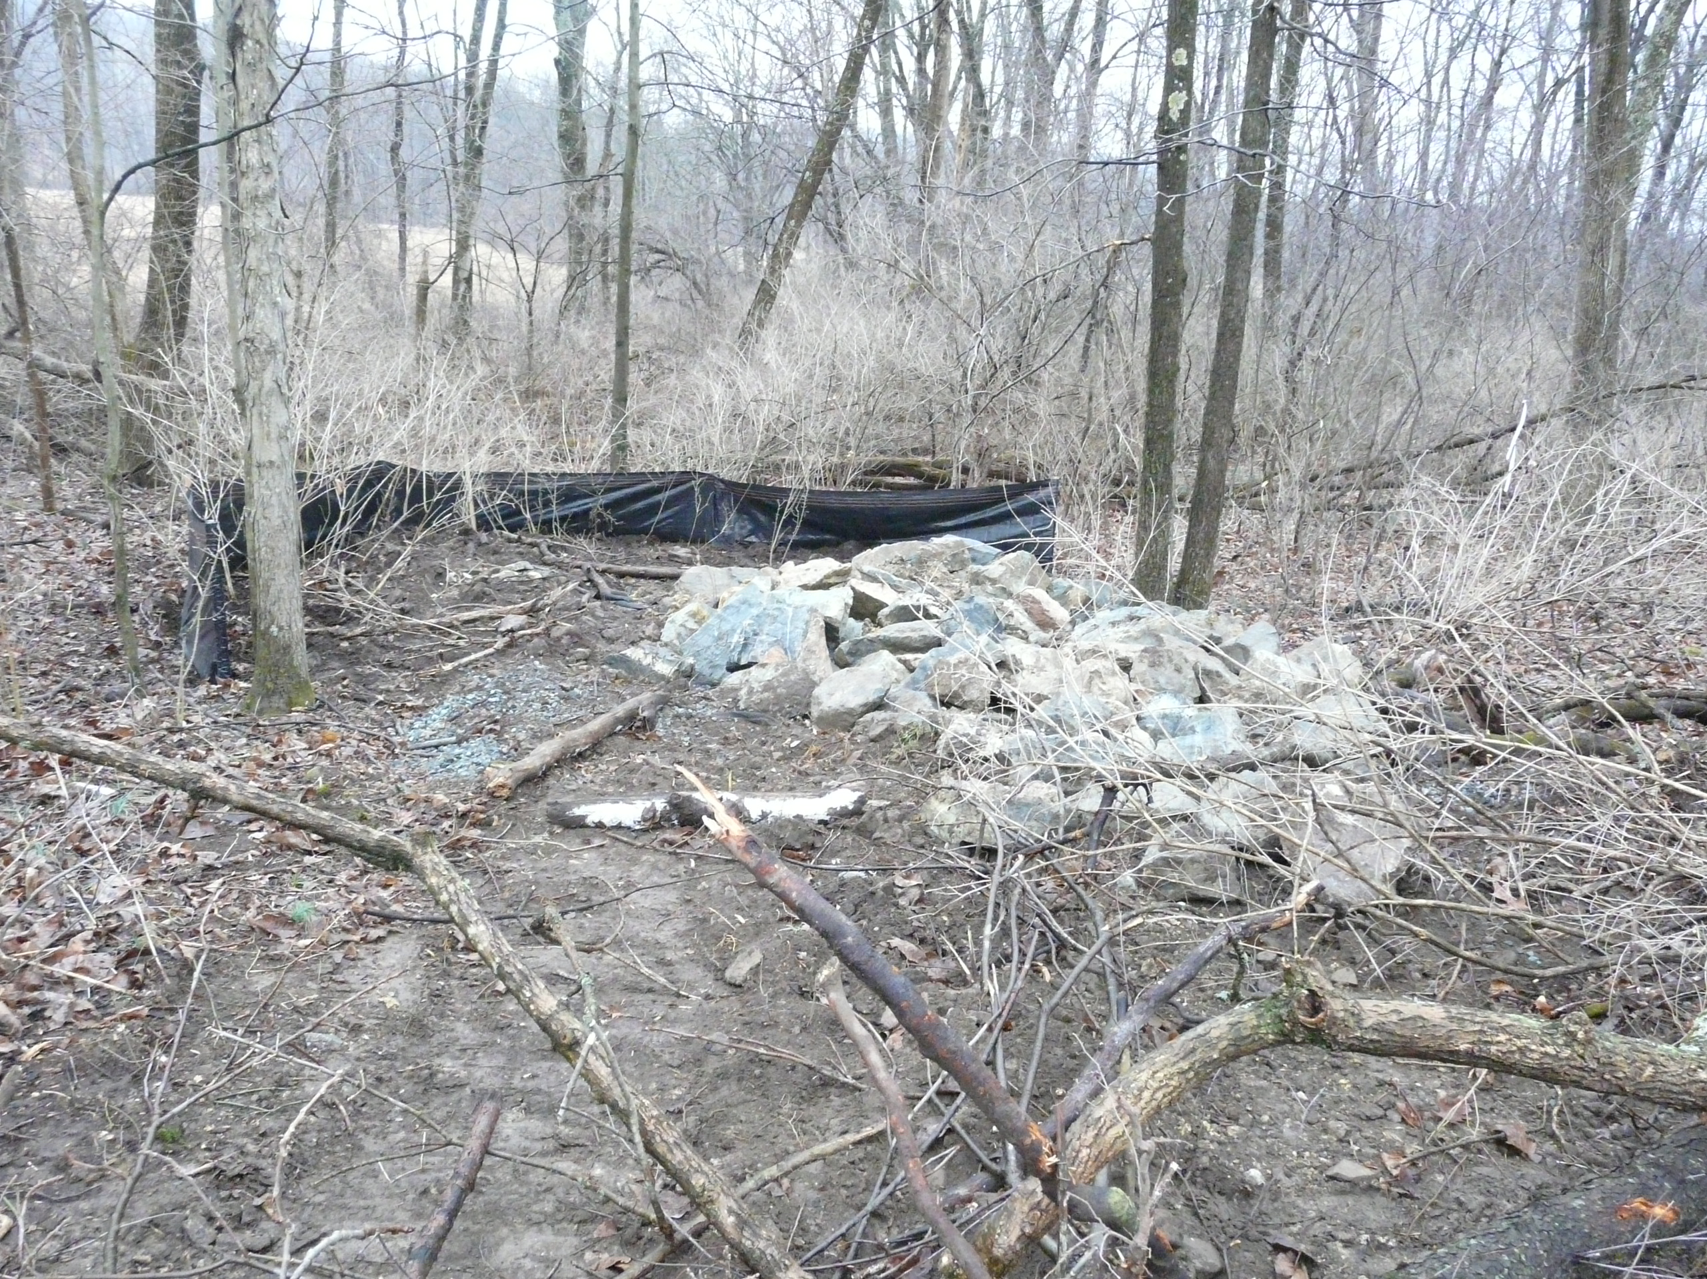
Discharge Gallery 1

Slide 13
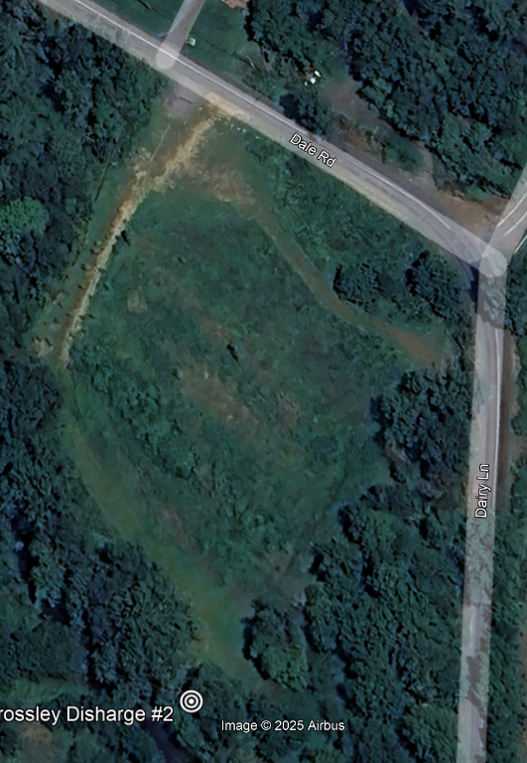
Discharge Gallery 2

Slide 14

Discharge Gallery 2

Slide 15
Brown Trout Temperature Endpoints
(Coutant 1975 , Bell 2006)​ (converted to Fahrenheit)
Temperature Endpoint​ | Temperature Value​
Complete Mortality Rate​ | Above 77° F​
High Mortality Rate​ | Above 71.6° F
Resistance Range​ | Between 68 to 71.6° F​
Tolerance Range​ | Between 64.4 to 68° F
Preference Range​ | Between 54.3 to 63.7° F
Spawning ​ | Between 41 to 50° F​

Slide 16
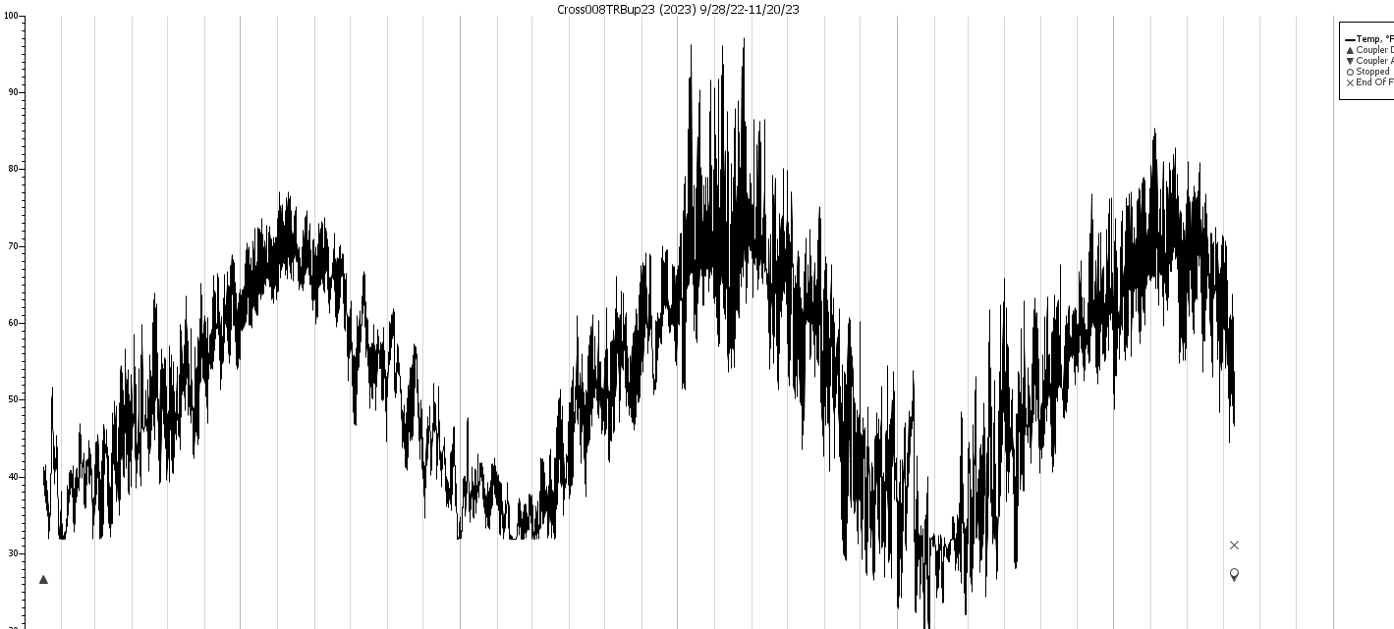
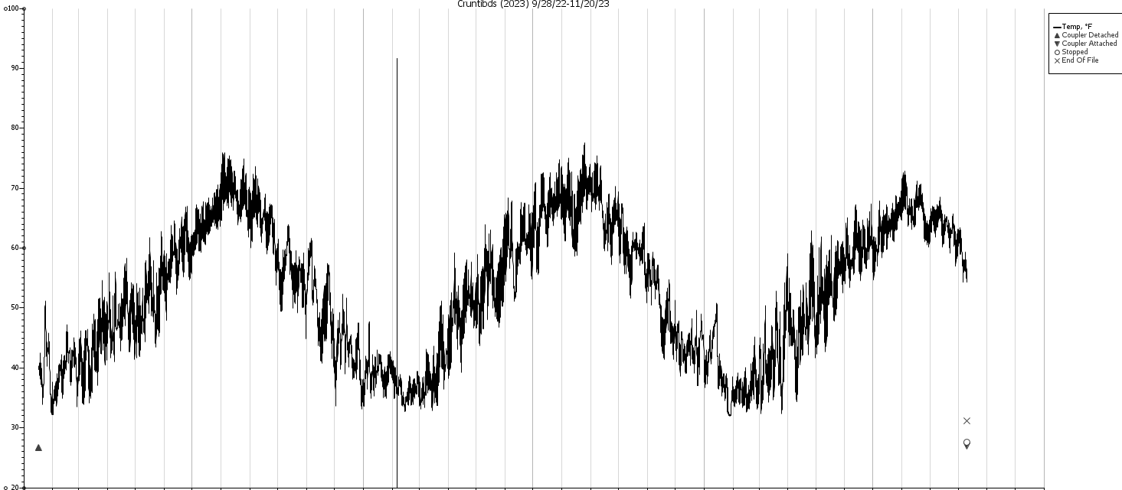
Unnamed Tributary – Discharge Gallery 1
Upstream
Good data from 23
9/28/22 to 11/20/23
Downstream of discharge

Slide 17
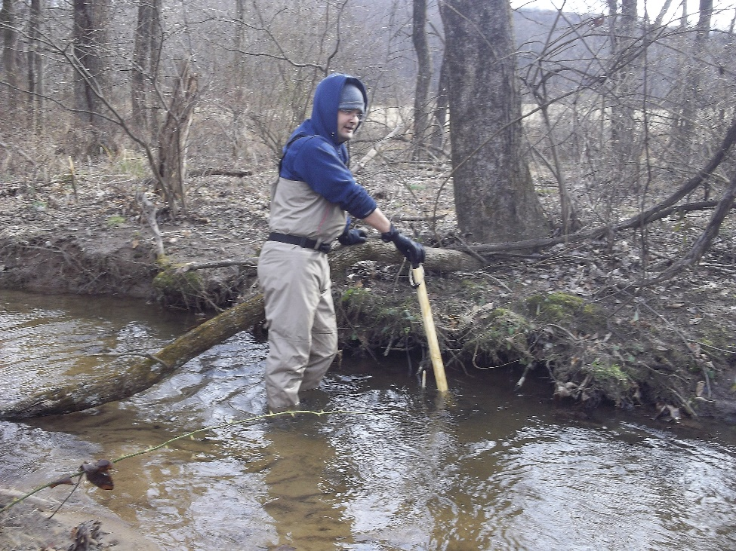
Location: Probe upstream of Discharge 1
Location: First probe downstream of Discharge 1

Slide 18
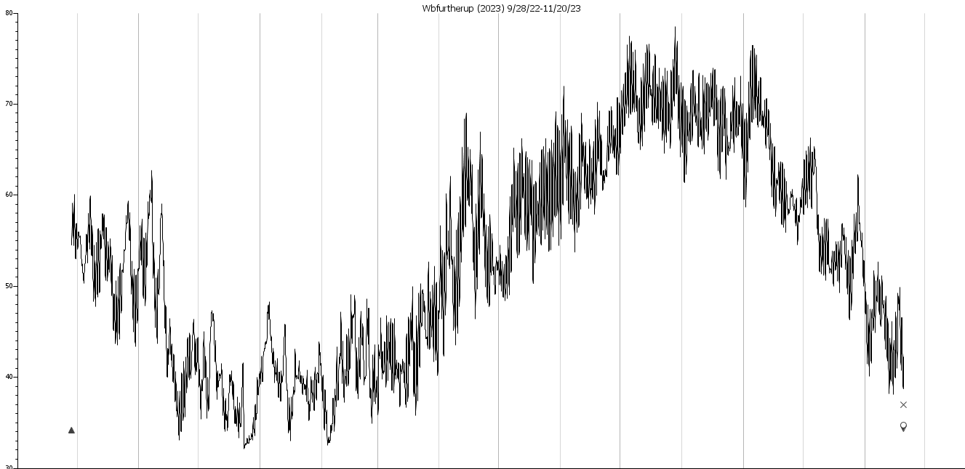
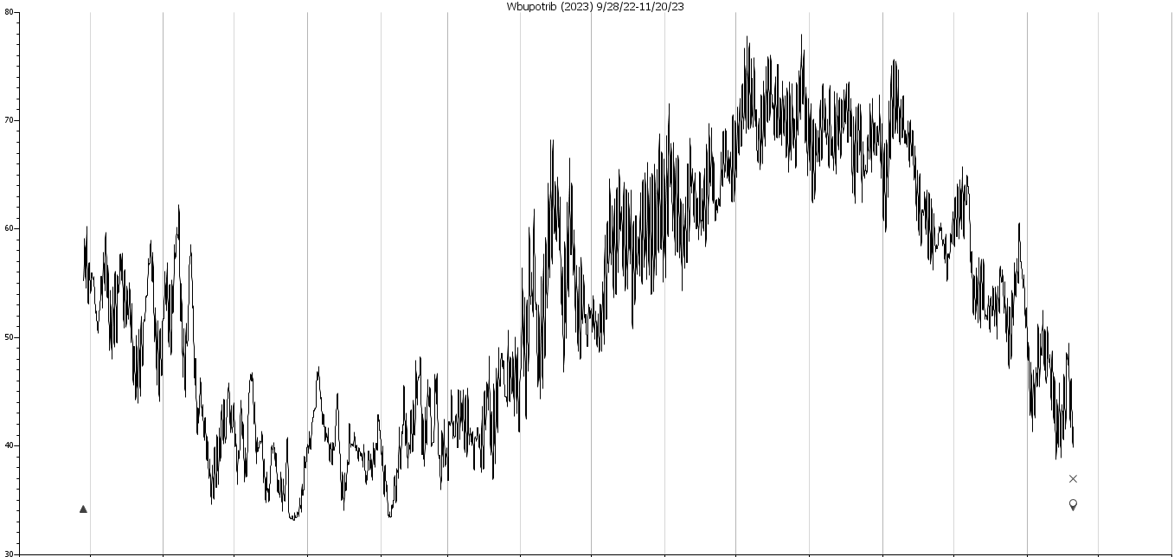
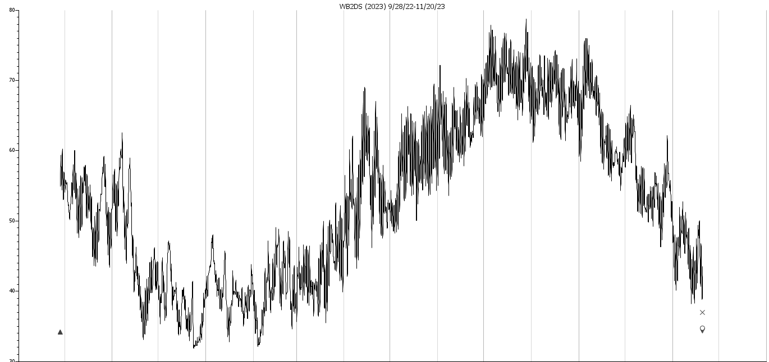
West Branch of Perkiomen – Discharge Gallery 2 9/28/22-11/20/23
At Discharge
Downstream of discharge
Furthest downstream

Slide 19
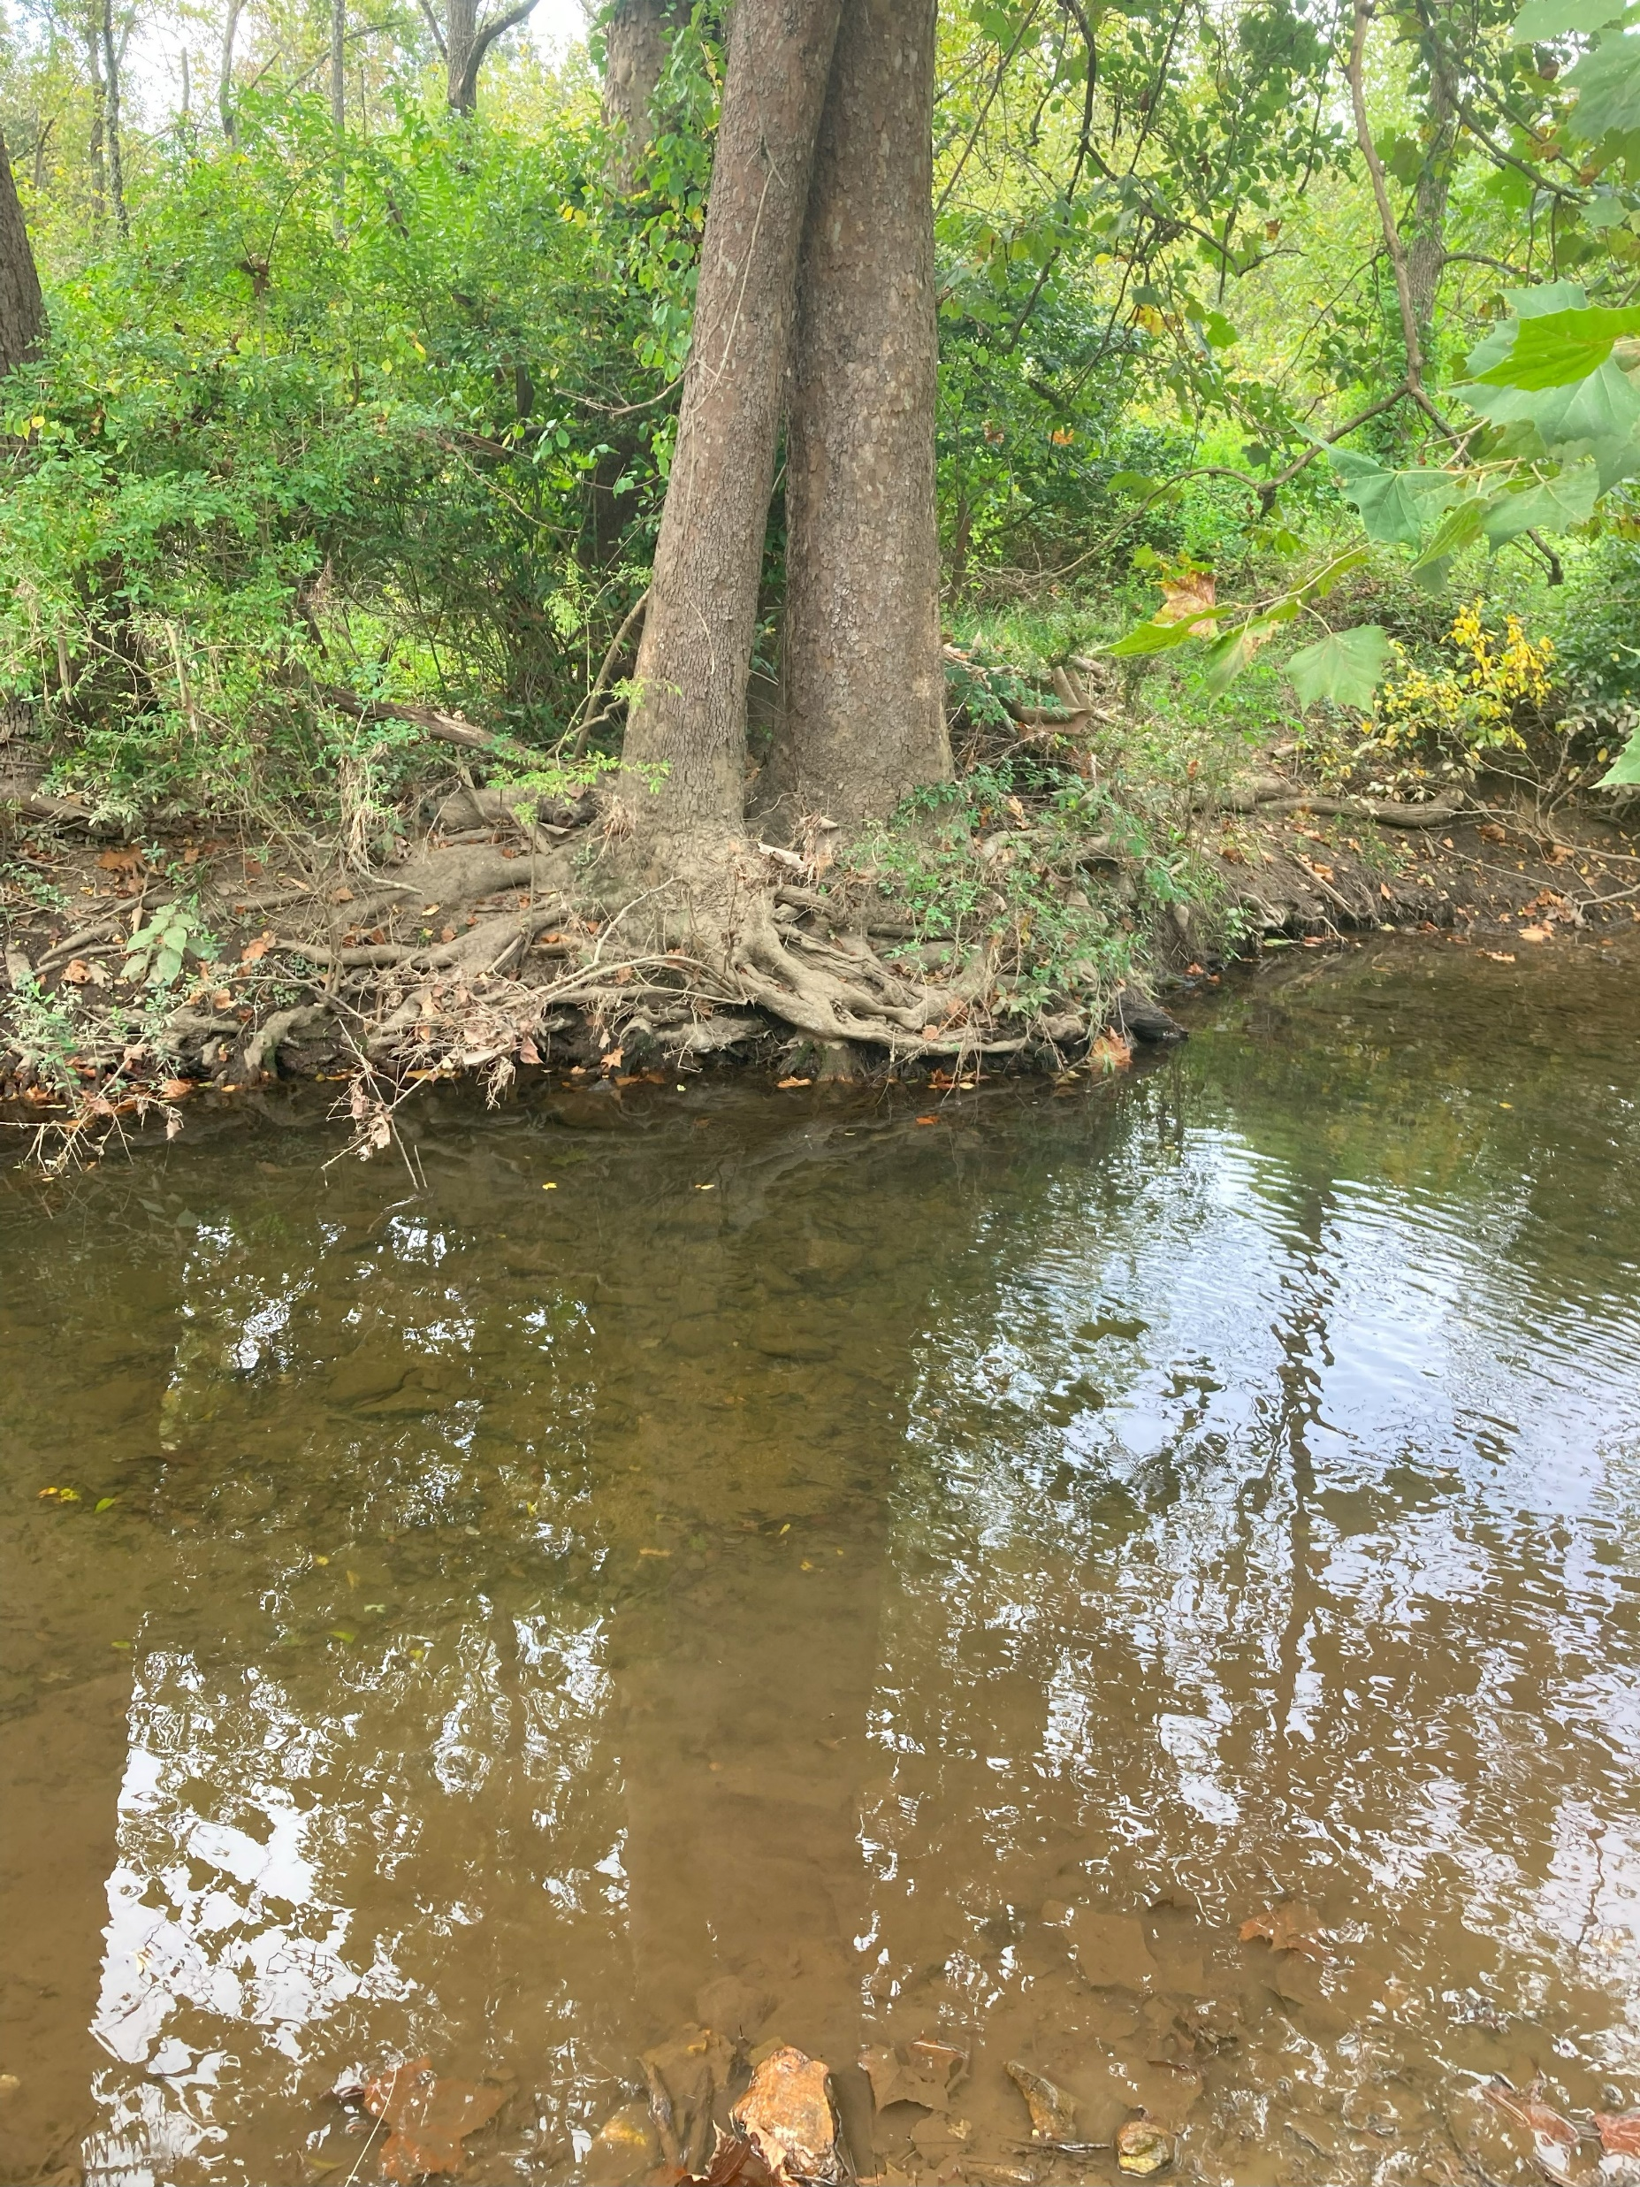
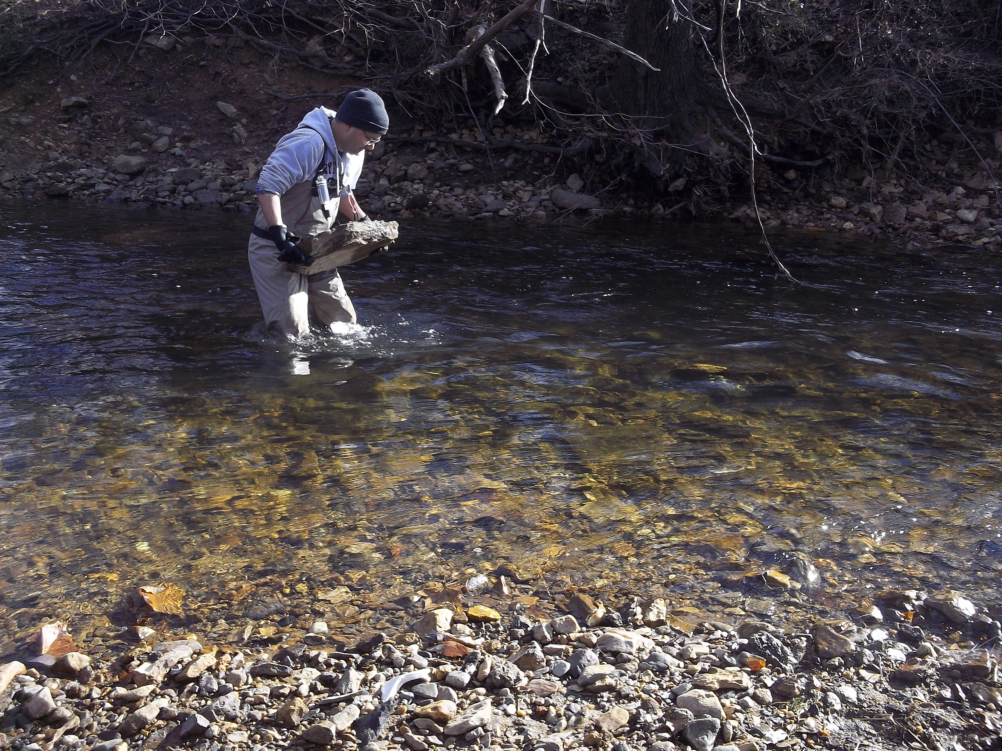
Location: First probe downstream of Discharge 2
Location: Probe at Discharge 2
Location: Furthest probe downstream of Discharge 2

Slide 20
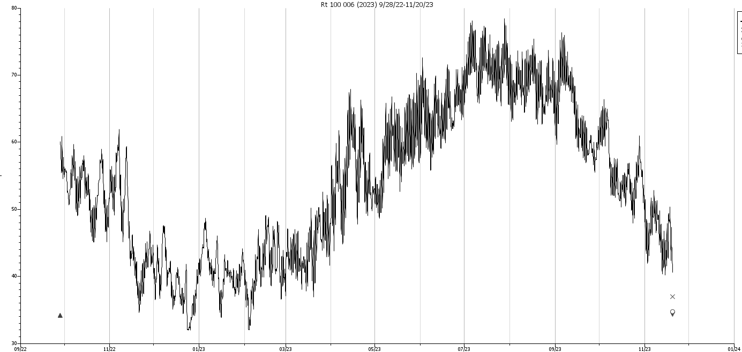
Further Downstream Data: 9/28/22 to 11/20/23 (No longer collected)
At Discharge 2
Downstream at Rt 100

Slide 21
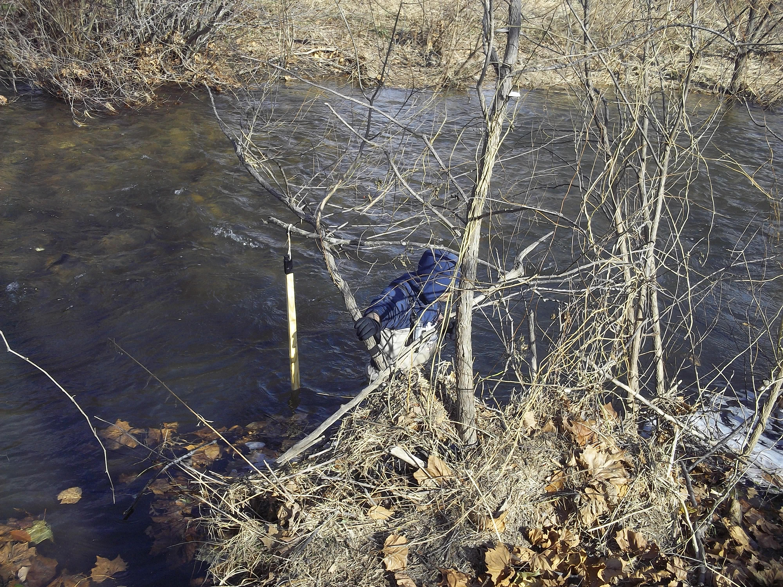
Location: Furthest probe downstream
(adjacent to Route 100)

Slide 22
Conclusion
Based on current data the site is protective of receptors.
Any exceedance of temperature endpoints is due to seasonal variation and not from site discharge.
Trout and other species would react accordingly and move to deeper pools or other parts of the watershed.

Slide 23
Maintain the HOBO® continuous temperature monitors at current 9 monitoring stations. Concentrate efforts closer to the site.
Increase monitoring frequency (2x a year).
Given the historical data, concentrate efforts closer to the site.
What's Next

Slide 24
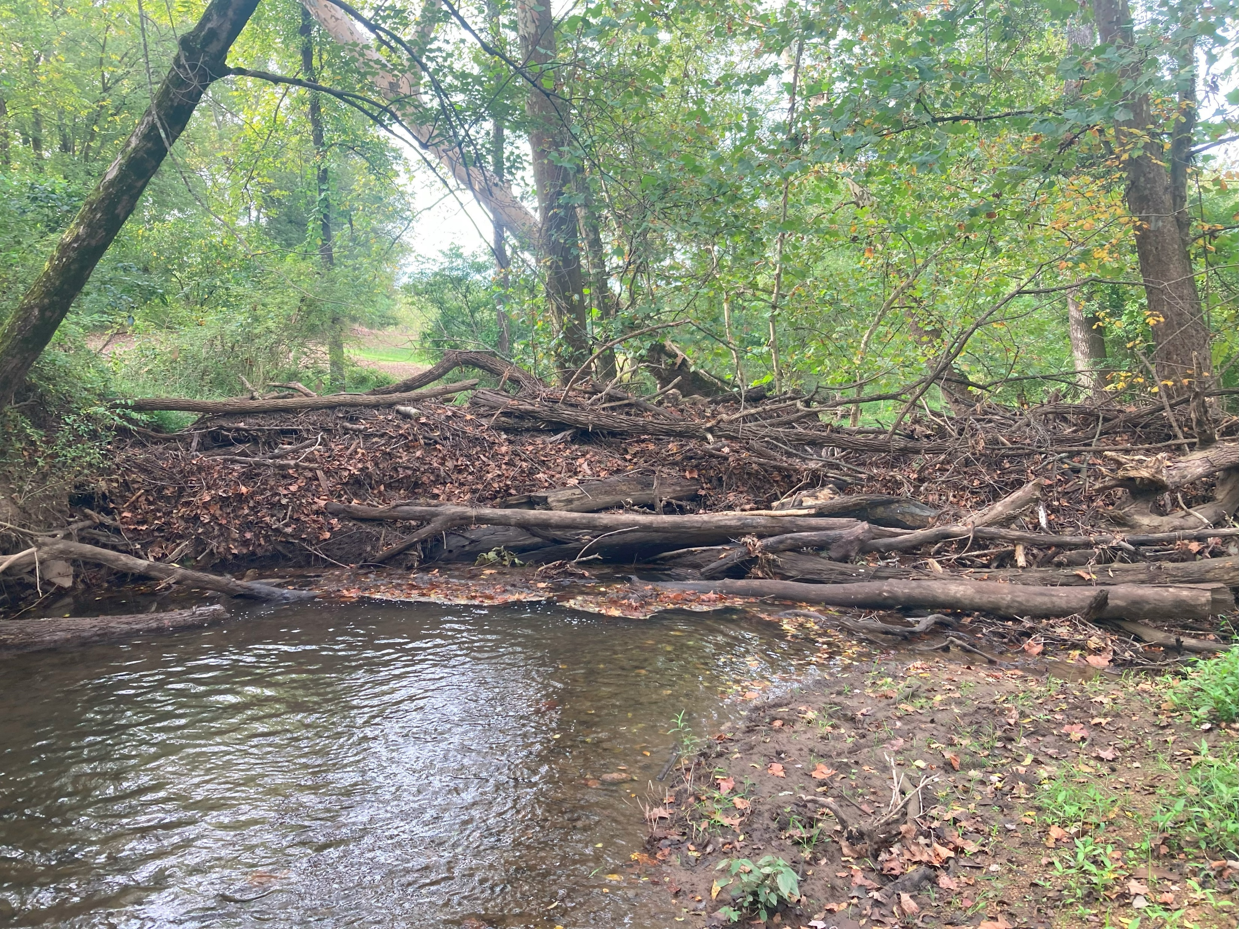
Questions for the group
Are there other creek/rivers near superfund sites you are concerned about?
What if any restoration work do you do for riparian corridors and in streams?
Concern with natural damming in area?

Slide 25
Questions? Contact Us
Leslee Everett
EPA Remedial Project Manager
(215) 814-2023
Everett.Leslee@epa.gov
Matt Taynor
EPA Biologist
(215) 814-3351
Taynor.Matthew@epa.gov
John Brakeall
EPA Community Involvement Coordinator
(267) 649-2977
Brakeall.John@epa.gov

